Slide 1


AIonLogic
BBxSYNC'25
AI that thinks with logic, built for precision.
Bonbloc Technologies Ltd
25-10-2025

Slide 2

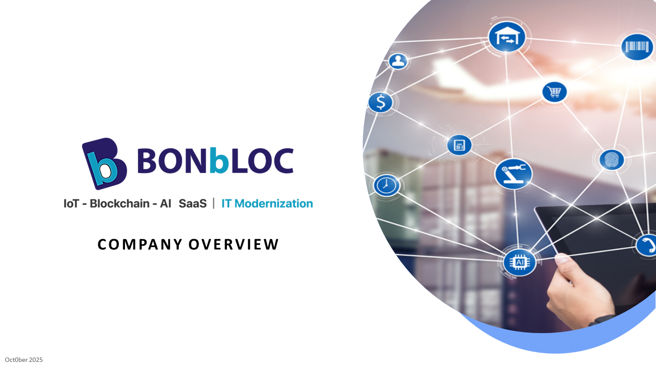

Slide 3
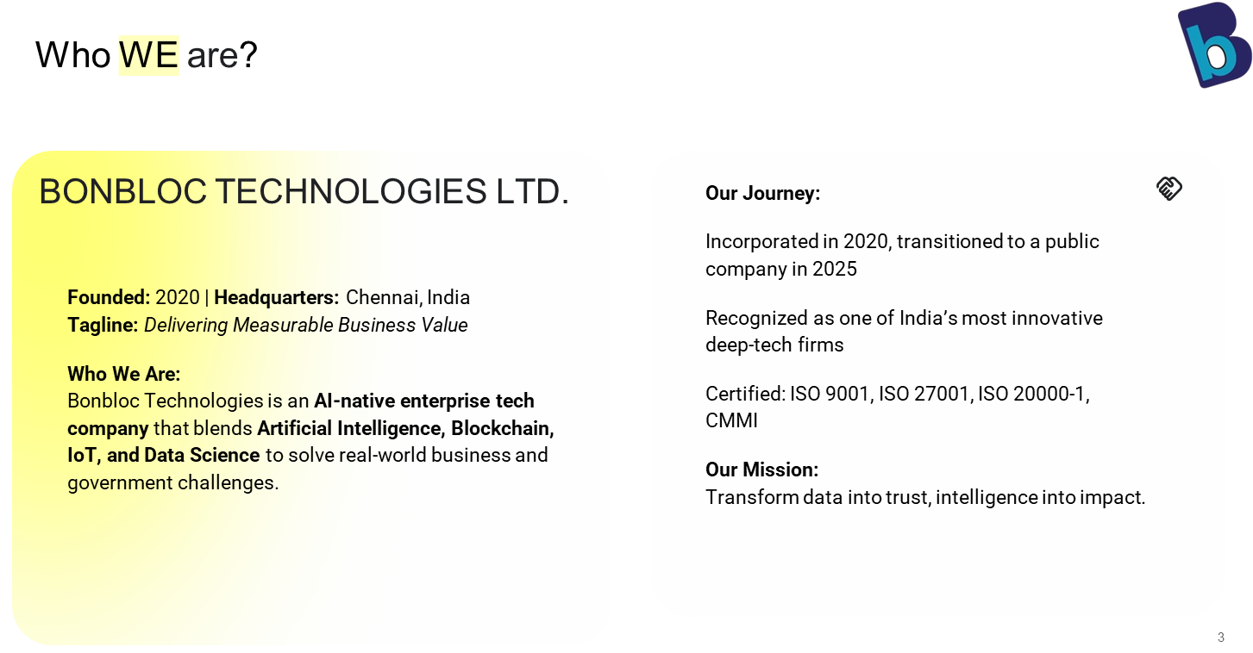

Slide 4
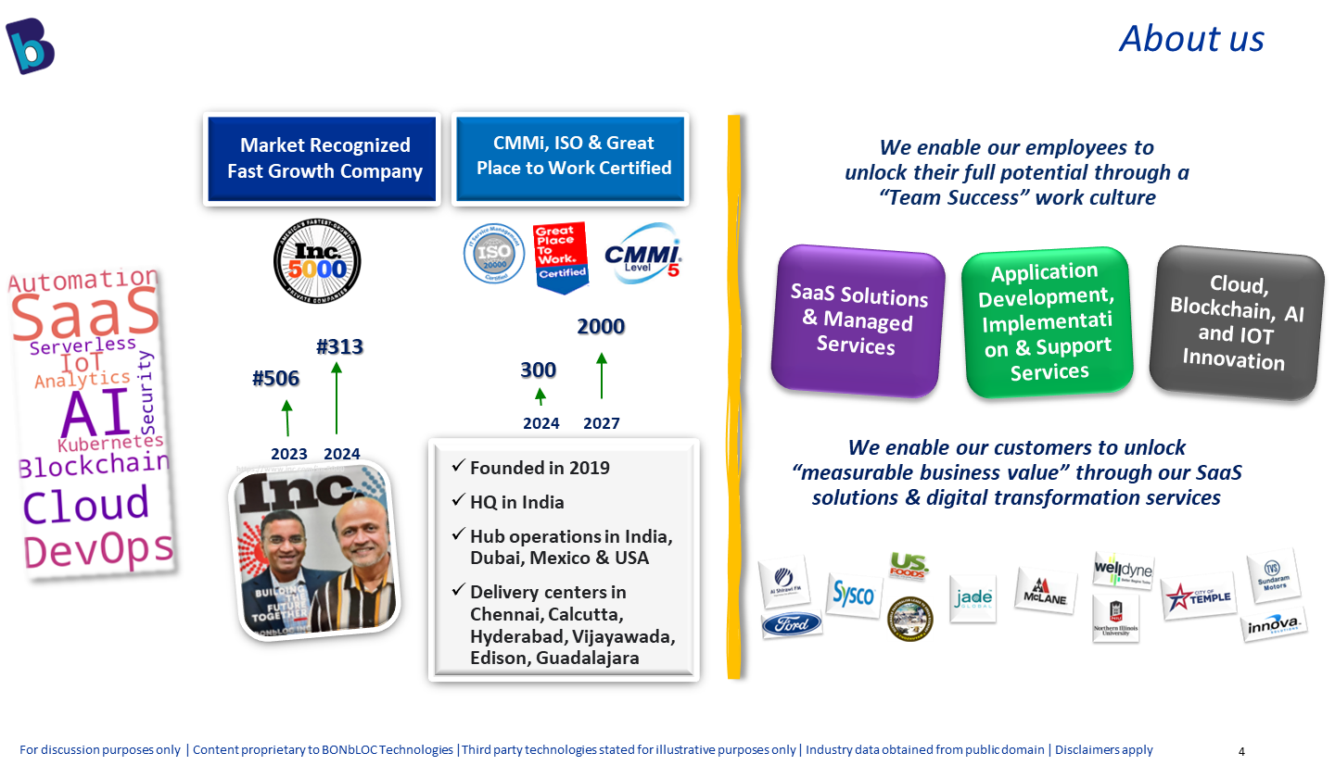

Slide 5
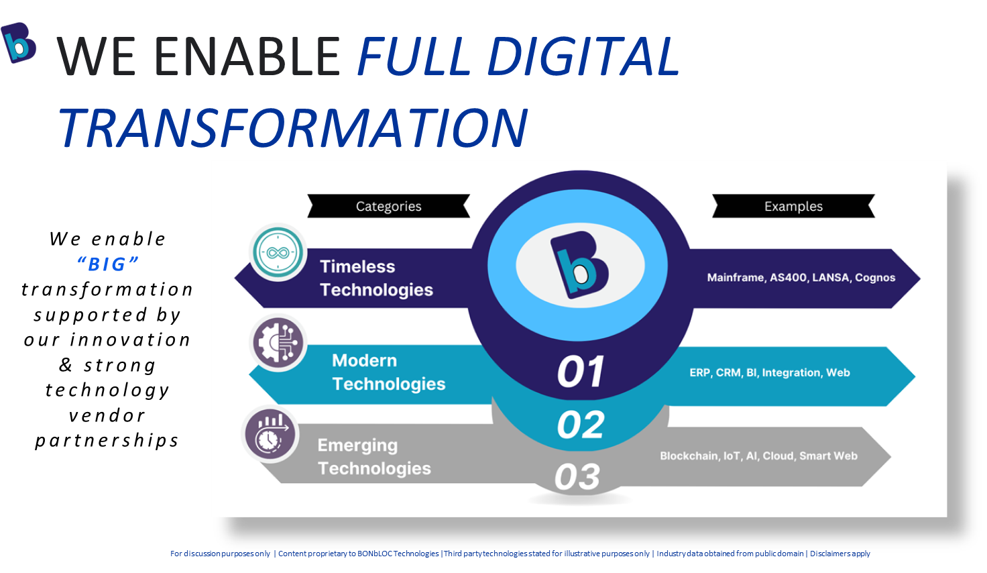

Slide 6
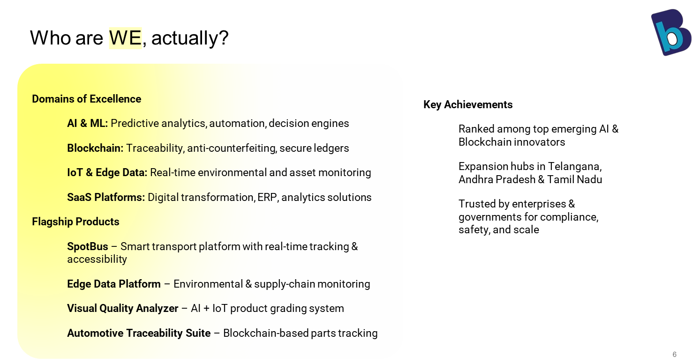

Slide 7
Today's Agenda
01
02
03
04
05
Foundations of Agentic AI
AI Environment & Setup
RAG & Reasoning
Langchain & Langraph
Capstone Project
Let’s build reasoning pipelines, orchestrate multi-agent flows and see AI act autonomously. Let’s make intelligence tangible!

Slide 8
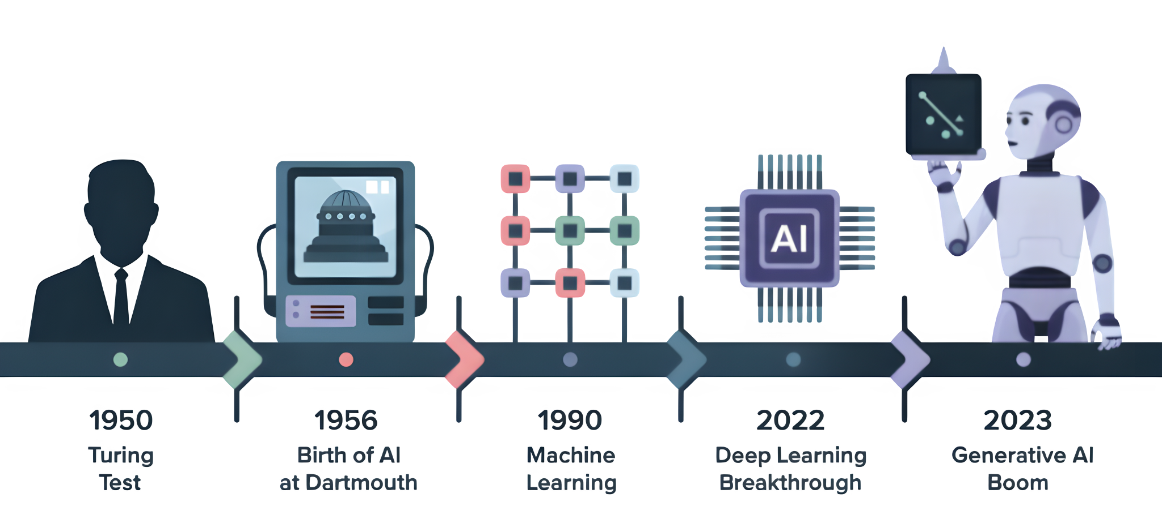
The Evolution of AI : From Prediction, to Creation, to Action

Slide 9
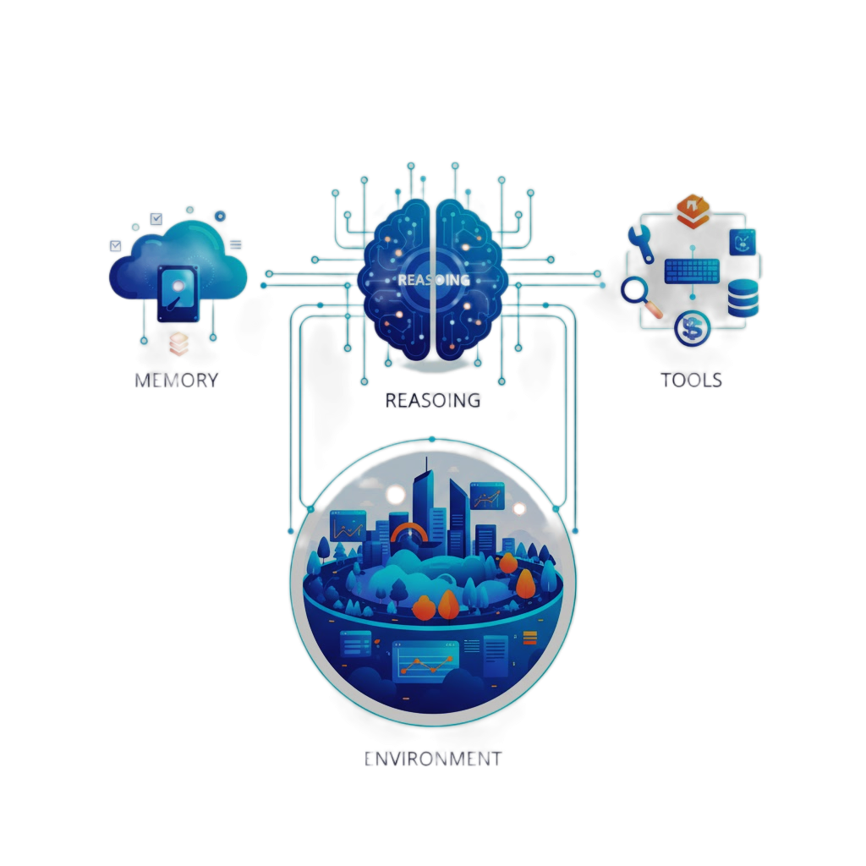
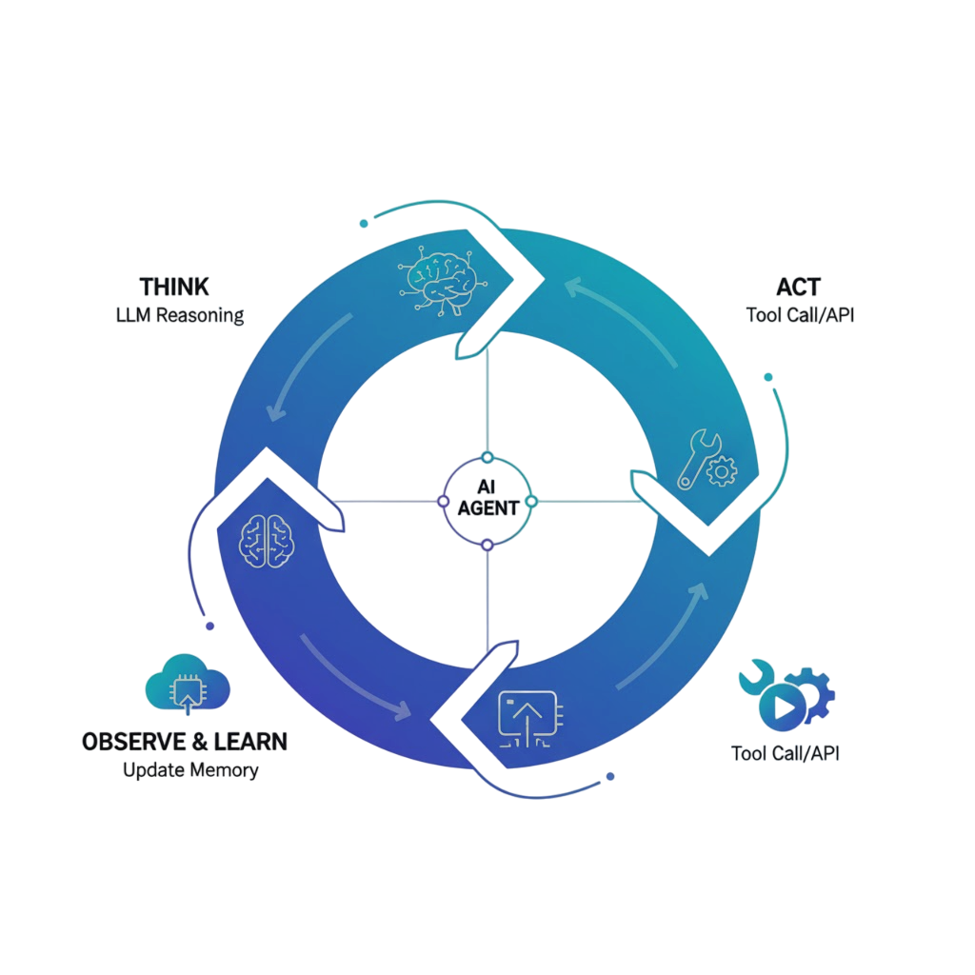
What Makes an AI Agentic?

Slide 10
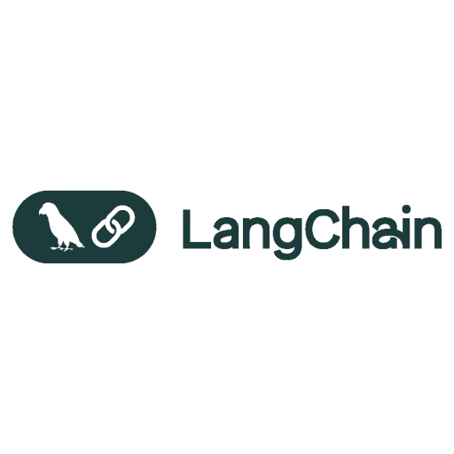




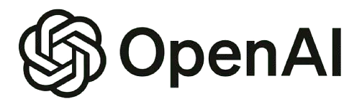

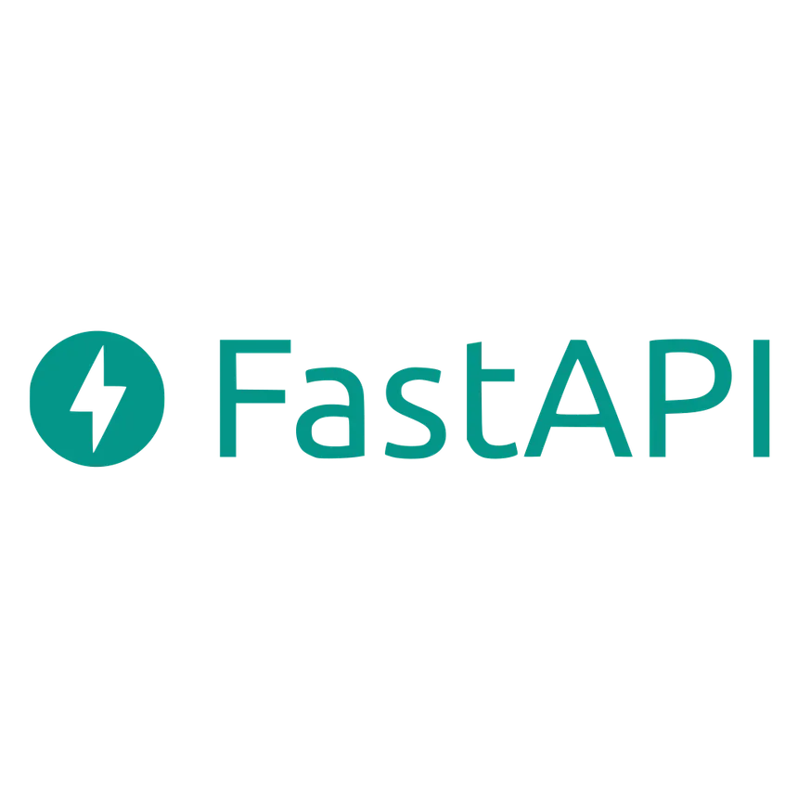
The AI Tech Stack & Setup

Slide 11
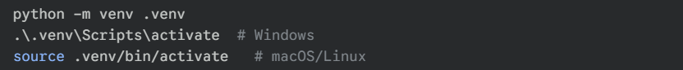
Building the ecosystem where reasoning agents live.
In Terminal: Create an isolated environment.
In VS Code:
Open Command Palette (Ctrl+Shift+P)
Run Python: Select Interpreter and choose your .venv.
Install extensions: Python, Jupyter, GitHub Copilot, Pylance.
Accessing AI Capabilities
Cloud APIs (Easiest Start)
Pros: No hardware needed, access to most powerful models.
Providers: Hugging Face (Open-source models), OpenRouter (Unified API for OpenAI/Anthropic/etc.), Groq (Extreme speed).
Local Inference (Full Control)
Pros: Data privacy, no API fees, works offline.
Tool: Ollama is the simplest way to download and run open-source models (like Llama 3) on your own machine.

Slide 12
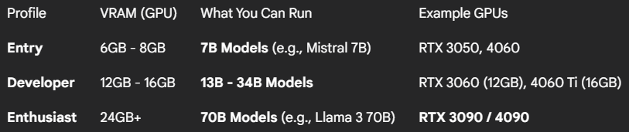
Local Inference: Hardware Requirements
The Golden Rule: VRAM (GPU Memory) is the most important spec. The entire model must fit into your VRAM for fast speeds.
No GPU? Your CPU + System RAM will work, but it will be very slow.
Apple Silicon (Macs): Unified Memory is excellent for local models.
Hardware Profiles (For Quantized Models)
Suggested Models: GPT-4 / GPT-4o, Mistral 7B, Qwen 2.5-VL, Llama 4

Slide 13
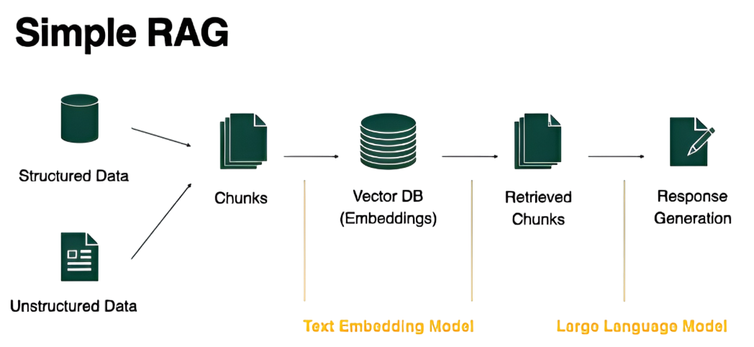
RAG & Reasoning - The Intelligence Layer
The Problem: Hallucination

Slide 14
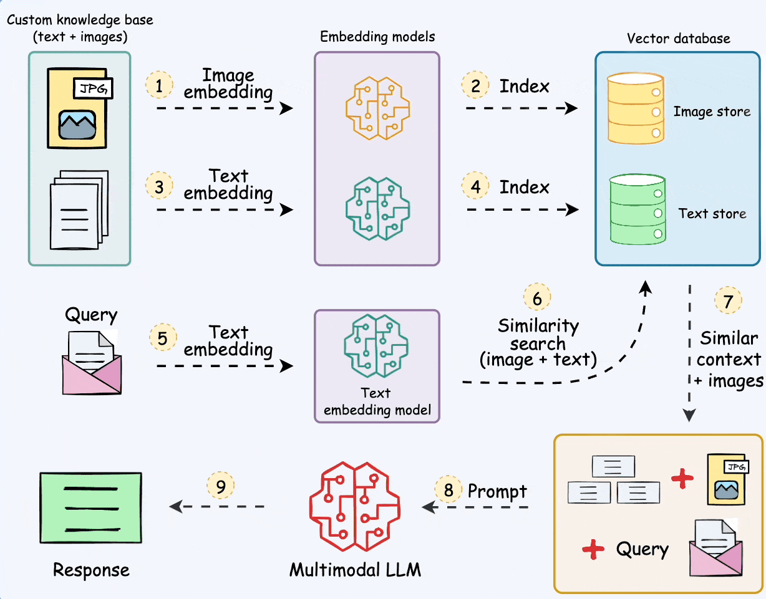
RAG & Reasoning - The Multi-Modal RAG

Slide 15
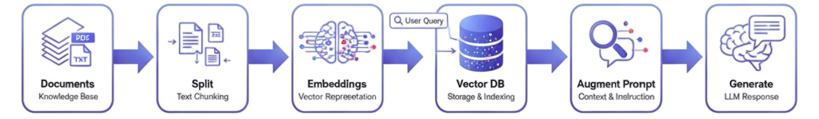
Under the Hood: Components of RAG
Common RAG (Retrieval-Augmented Generation) pipeline:
Ingestion (Document Loaders): The process starts with LangChain Loaders, which ingest your raw data (like PDFs, text files, or web pages).
Chunking (Text Splitters): The Recursive Splitter takes that raw data and breaks it down into smaller, more manageable chunks.
Vectorizing (Embeddings): Ollama Embeddings are then used to create numerical (vector) representations of each chunk, capturing its semantic meaning.
Indexing (Vector Store): These vectors are loaded into ChromaDB, which acts as the "memory" for the agent, allowing for efficient similarity searches.
Retrieval (Retriever): When a user asks a question, the LangChain Retriever queries the ChromaDB to find the top-k (most relevant) chunks of information related to the query.
Generation (Generator): Finally, the original user question and the retrieved chunks of context are passed to the Ollama / LLM. The LLM then synthesizes this information to generate a final, context-aware answer.

Slide 16
Leveraging LangChain
Hands-On Demo
LangChain is a framework for building applications with Large Language Models (LLMs) by connecting components in a sequence (a "chain"). It provides essential building blocks for an LLM application:
LLM Wrappers: Standard interface to connect to various LLMs (e.g., ChatOpenAI, ChatAnthropic, Ollama).
Prompts: Templates that format user input and context into model-understandable messages (e.g., PromptTemplate, ChatPromptTemplate).
Output Parsers: Format LLM's raw text response into structured formats (e.g., StrOutputParser, JsonOutputParser).
Document Loaders: Tools to ingest data from different sources (e.g., PDFLoader, WebBaseLoader).
Text Splitters: Utilities to break large documents into smaller chunks (e.g., RecursiveCharacterTextSplitter).
Vector Stores: Integrations with databases to store and search information (e.g., Chroma, FAISS).
Retrievers: Logic to fetch relevant data from your vector store.
Chains (LCEL): The "glue" (LangChain Expression Language) that pipes all components together.

Slide 17
How to Choose an LLM for RAG
The LLM is your "Reasoning Engine." Its job is to synthesize the final answer.
1. Instruction Following (Most Critical)
Can the model strictly follow commands like "Answer only from the context"?
Top-tier models (GPT-4o, Claude 3) excel at this.
2. Context Window Size
Must be large enough to fit your prompt + all retrieved chunks.
Larger windows (128k+) are safer for complex queries.
3. RAG Benchmarks
Look for performance on "open-book" QA datasets (e.g., HotpotQA, NarrativeQA).
4. Cost & Speed
Balance performance (e.g., GPT-4o) with the speed/cost of smaller models (e.g., Llama 3 8B).
Recommendation: Start with a high-performance model to set a benchmark, then test faster/cheaper options.

Slide 18
How to Choose an Embedding Model
This model turns your text into vectors. Your retrieval quality depends on it.
1. Check the MTEB Leaderboard
The "Retrieval" score on the Massive Text Embedding Benchmark (MTEB) is your best metric.
2. Match Your Domain
For general text, use a top MTEB model.
For specialized text (e.g., legal, medical), find a domain-specific model (like BioBERT).
3. Dimensions vs. Cost
Higher dimensions = More nuance, but slower & more expensive.
Lower dimensions = Faster & cheaper.
4. Sequence Length
The model's max tokens (e.g., 512) must be larger than your chunk size.
Recommendation: Start with a top-ranked, well-balanced model from the MTEB leaderboard.

Slide 19
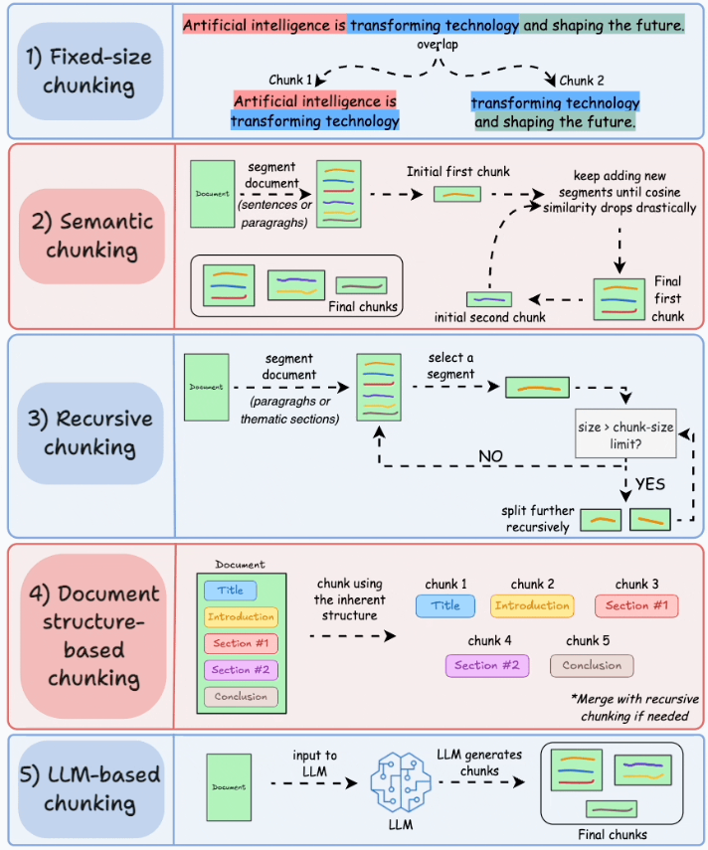
How to Choose a Chunking Strategy
This is how you break up documents. Goal: Create "semantically complete" chunks.
NEVER use fixed-size chunking.
ALWAYS use chunk overlap (e.g., 10%).
Your strategy depends on your document type:
Unstructured Text (Articles, Reports)
Strategy: Recursive Character Splitting
Why: Tries to split by paragraphs (\n\n), then sentences, then words. Keeps logic together.
Structured Text (HTML, Markdown)
Strategy: Structure-Aware Splitting
Why: Splits by logical tags (#, ##, <div>, <table>) so you don't break a table in half.
Code (Python, JS)
Strategy: Language-Specific Splitting
Why: Splits by functions or classes, which is much more effective.

Slide 20
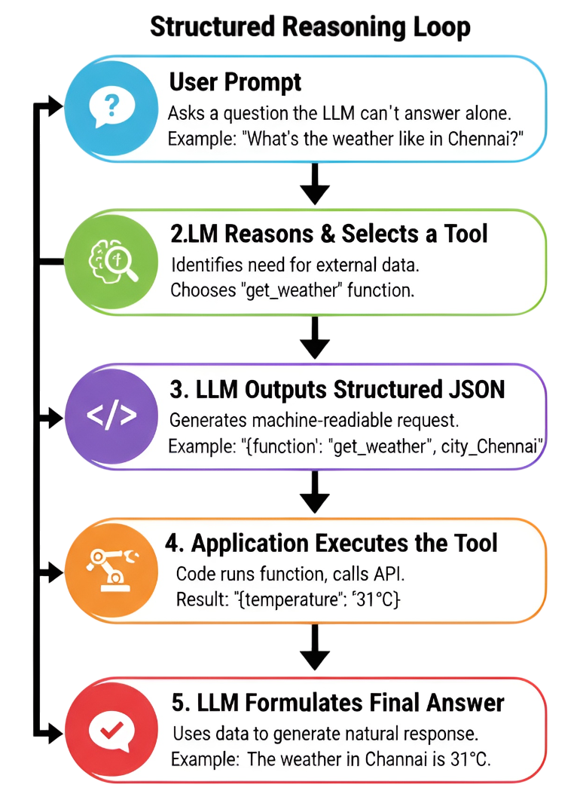
How LLMs Act: Function Calling 101
Function Calling is the bridge between an LLM's text-based reasoning and real-world actions. It allows the model to request that our code execute a function on its behalf.
How does the LLM know how to format that JSON request? We give it a 'manual' for each tool, which is a schema that describes what the tool does and what it needs
This schema tells the LLM everything it needs to know. The description is the most critical part for its reasoning—it's how the LLM decides when to use the tool. The parameters tell it how to ask for it, ensuring the request is perfectly formatted every time.

Slide 21

Langgraph
LangGraph, the Flow Engine for Agents, is a library built on top of LangChain to solve its primary limitation. It allows you to create complex, stateful applications with cycles.
It lets you define your workflow as a graph, where each step is a "node" and the "edges" are the connections that determine the next step. This structure is essentially a state machine.
Nodes: These are your functions or computation steps. A node can be a call to an LLM, a call to a tool (like a search engine), or any other piece of Python code. Examples: Any Python function, or a LangChain chain (Runnable).
Edges: These are the paths that connect the nodes. You can create conditional edges that decide which node to go to next based on the result of the current node (e.g., "If the LLM needs a tool, go to the 'Tool' node. If not, go to the 'Final Answer' node.").
State(GraphState): It maintains a persistent "state" object that is passed between nodes, allowing the application to keep track of its memory, the conversation history, or the steps it has already taken. Examples: A TypedDict you define, like class AgentState(TypedDict): messages: Annotated[list, add_messages].
Checkpointers: The "save button." This component automatically saves the State after each step, allowing your agent to be paused, resumed, or rolled back. Examples: MemorySaver (for in-memory) or integrations with databases like SqliteSaver or RedisSaver.

Slide 22
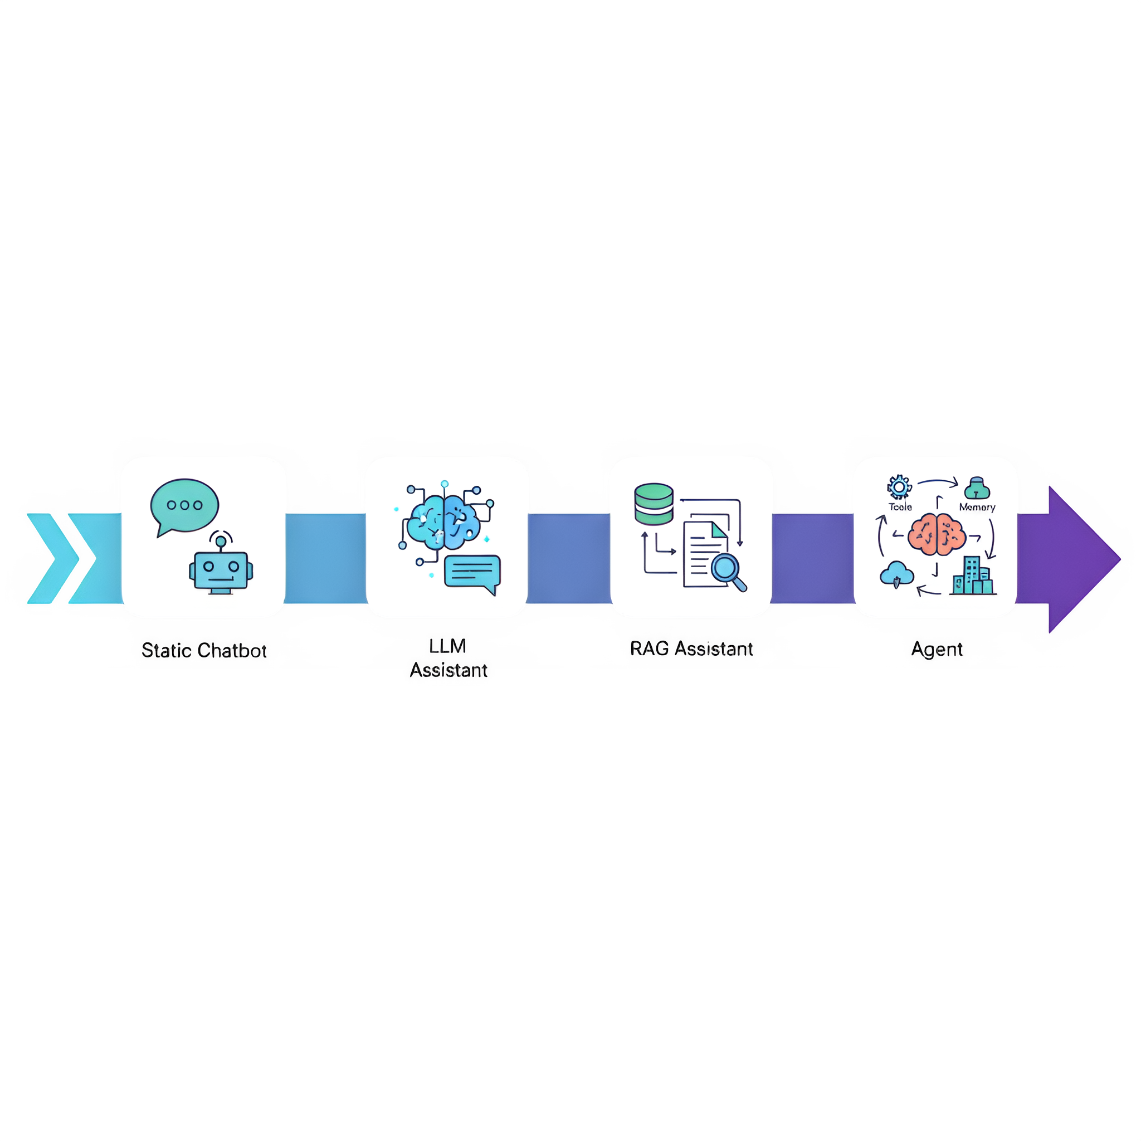
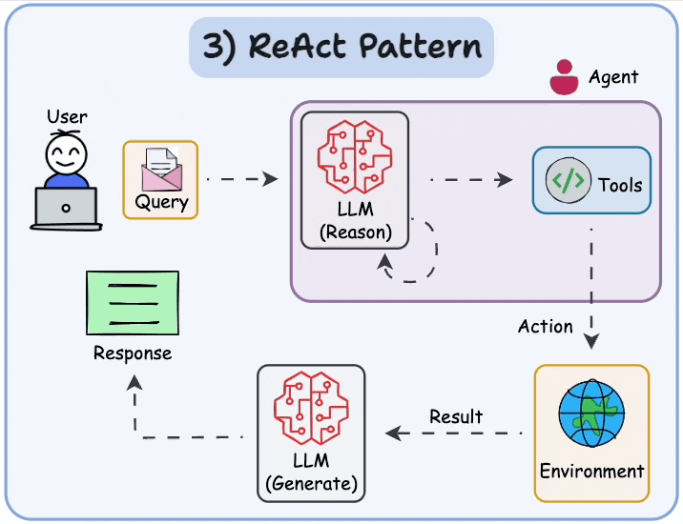
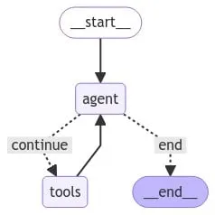
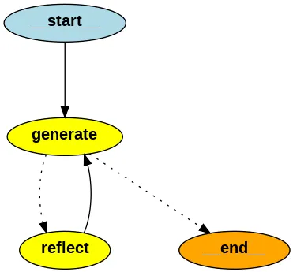
The Journey : From Chatbots to Agents

Slide 23

Capstone Project
AI Research & Insight Agent
AI Research & Insight Agent : A multi-agent system that plans, retrieves, analyzes, and reports insights.
Project Link:
https://github.com/VigneshMoovendhan/BBxSYNC25/tree/main/langgraph/10_multi_agent_architecture
Hands-On: Building the Multi-Agent Crew

Slide 24
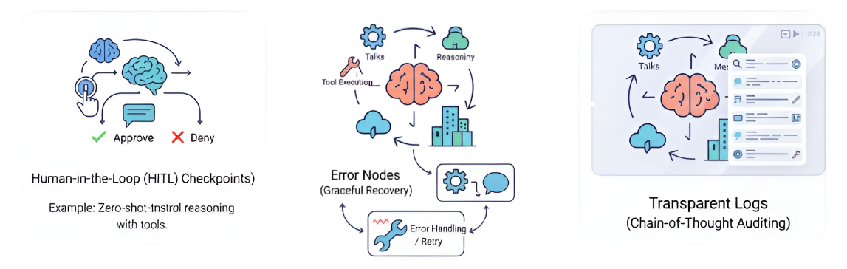
Control, Feedback & Recovery
An autonomous agent is a powerful tool, but an unpredictable one is a massive liability.
Three mechanisms (Control, Feedback, and Recovery) that move an agent from a "cool demo" to a "mission-critical" system.
Human-in-the-Loop (HITL) Checkpoints : This is a "pause button" for your agent. You define a set of actions that are too sensitive for the AI to execute on its own. Instead of acting, the agent proposes the action and waits for a human to approve or deny it.
Error Nodes (Graceful Recovery) : This is the agent's ability to handle failure without crashing. In traditional programming, an unhandled exception stops the entire program. In an agentic workflow, an exception should be just another piece of information to learn from.
Transparent Logs (Chain-of-Thought Auditing) : This is the "glass box" that lets you see exactly how an agent arrived at a decision. It's a complete, step-by-step trace of the agent's internal monologue, tool calls, and observations.

Slide 25

Responsible Agentic Systems have
Transparent Reasoning: Provide clear logs of the agent's thought process.
Controlled Execution: Use sandboxing to limit what tools can do.
Human-in-the-Loop (HITL): Require user confirmation for critical actions.
Safety Limits: Implement rate limits to prevent abuse or errors.
Clear Policies: Maintain a transparent data retention policy.

Slide 26

Business Use Cases
Market Intelligence: This means automatically tracking your entire industry. Instead of you manually searching for trends, the system finds and analyzes data on customer behavior, market size, and new demands for you.
Competitor Research: This is similar but focuses only on your rivals. The system scans news, websites, and social media from multiple competitors and gives you a single, short summary of what they're doing (like launching a new product or starting a new ad campaign).
Tech Scouting: This is like having a scout looking for the "next big thing." The system actively searches for new technologies, innovative startups, or scientific breakthroughs that could either help or disrupt your business in the future.
Knowledge Automation: This focuses inside your company. It takes all your complex internal documents (like long reports, research papers, or manuals) and automatically turns them into simple summaries or key takeaways, so employees can get the information they need quickly.

Slide 27
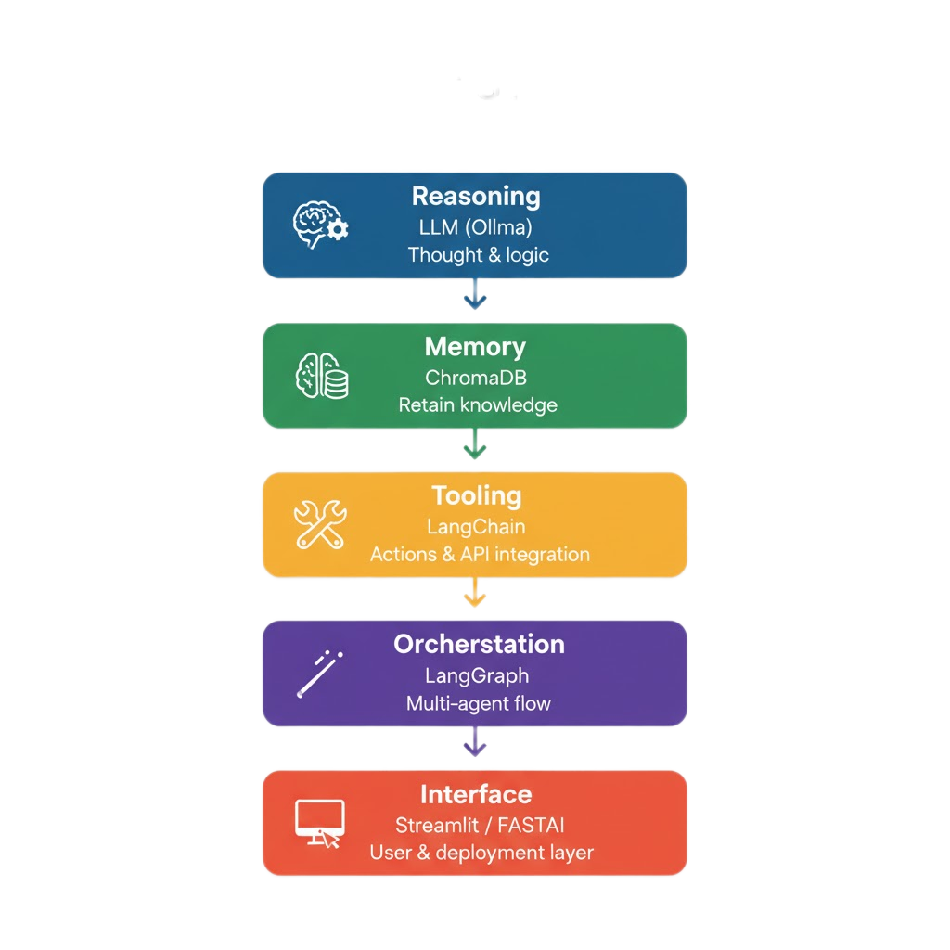
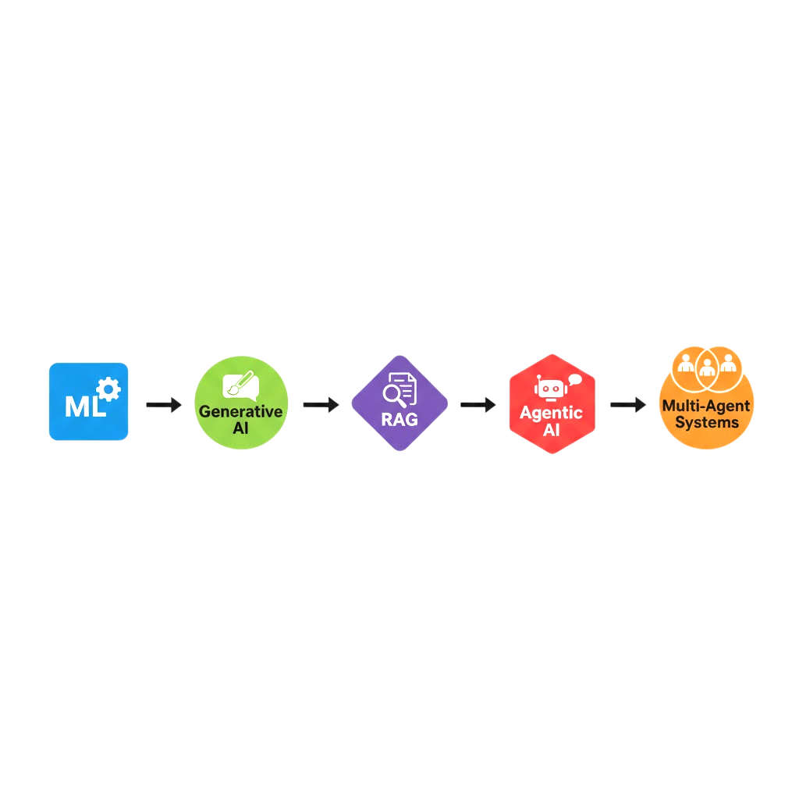
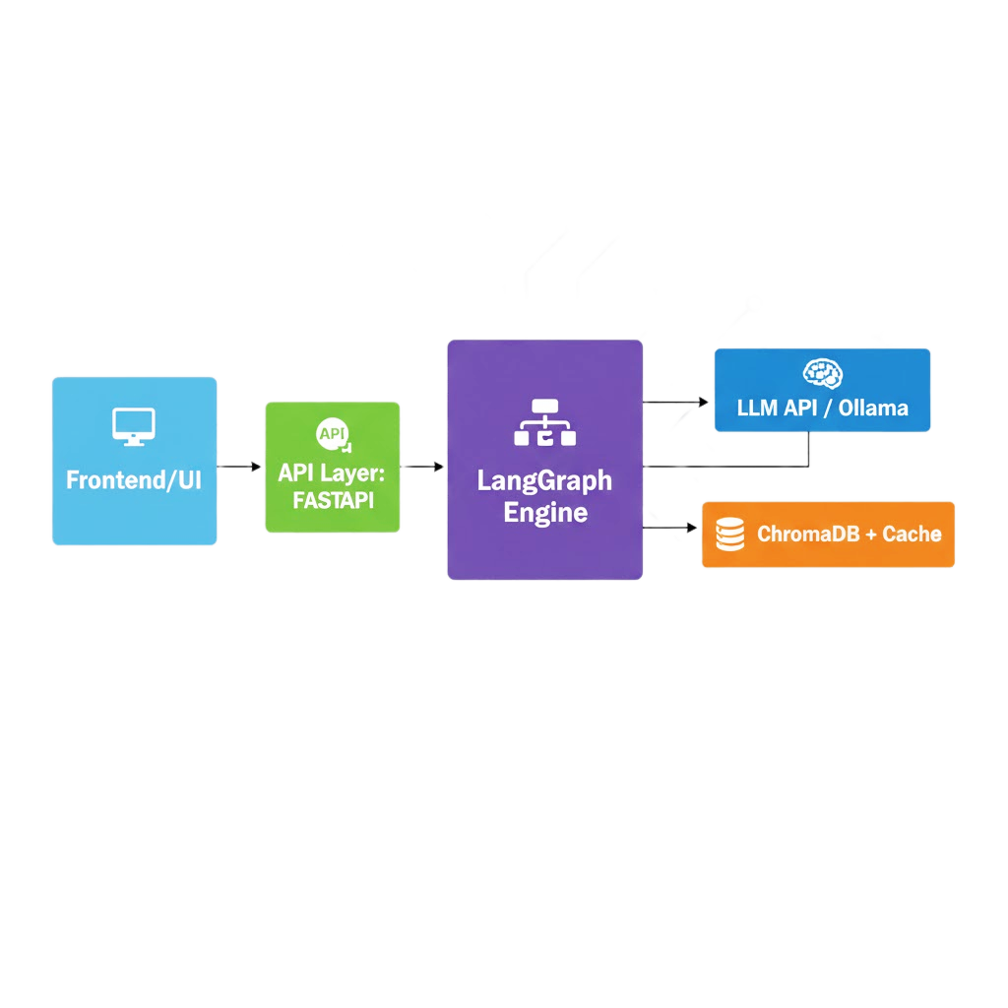
Wrapping Up

Slide 28
You have learnt to…
Resources:
✅ Understand agentic AI fundamentals.
✅ Build RAG + reasoning pipelines.
✅ Orchestrate multi-agent systems with LangGraph.
✅ Outline a deployment and monitoring strategy.
✅ Design for safety and continuous improvement.
🔗 LangChain Docs – https://python.langchain.com 🔗 LangGraph Docs – https://langchain-ai.github.io/langgraph 🔗 Ollama Models – https://ollama.ai/library 🔗 Workshop GitHub Repo - https://github.com/VigneshMoovendhan/BBxSYNC25.git
What part of agentic AI excites you most — reasoning, retrieval, or orchestration?
Thank You!

